Slide 1
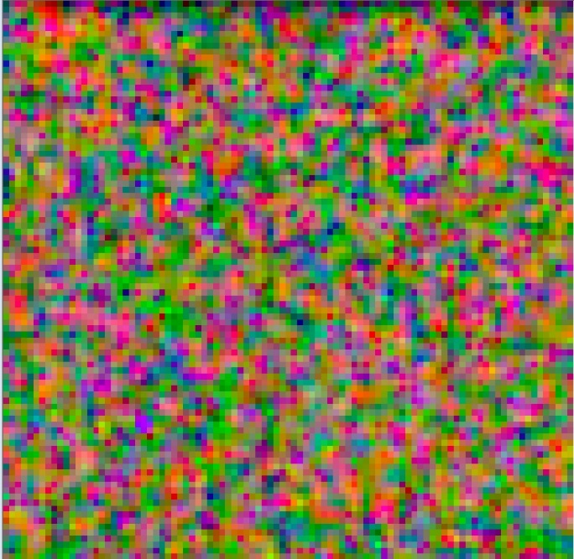
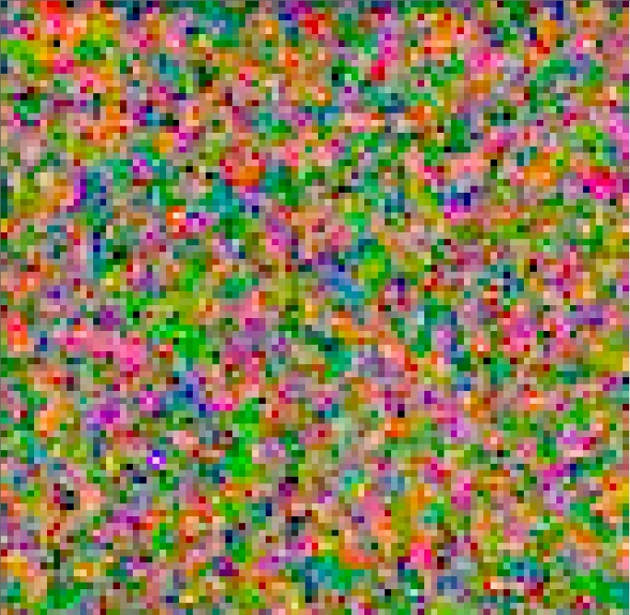
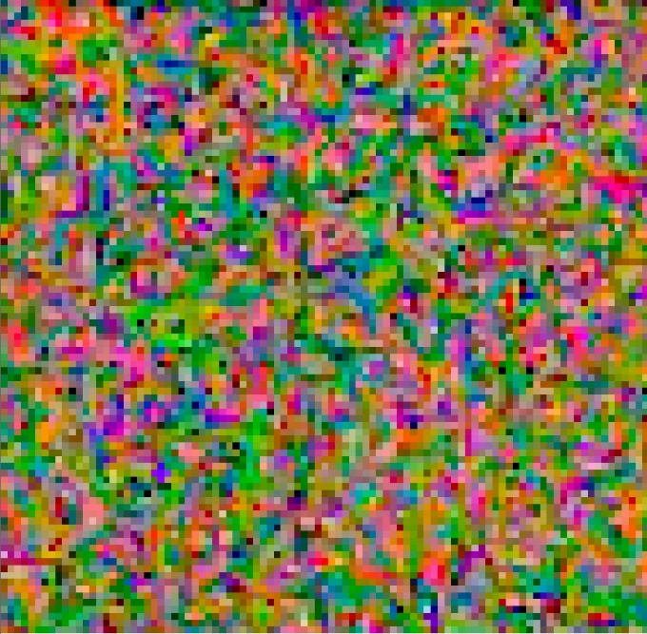
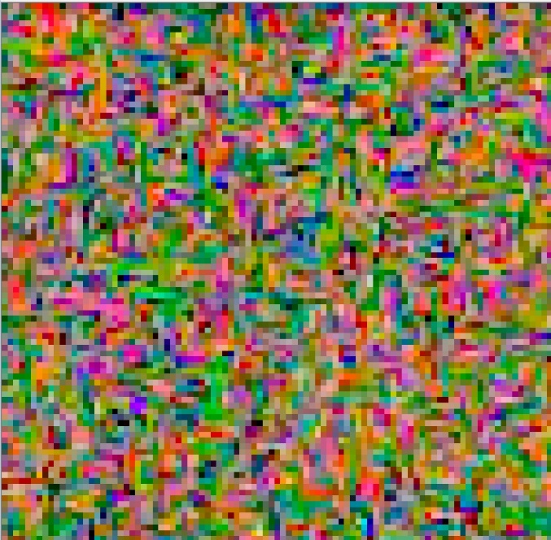
Difference between interpolation methods for real low-light image
Bilinear
Variable Number of Gradients
Patterned Pixel Grouping
Adaptive Homogeneity-Directed
Reconstructed from *.cr2 using dcraw with flags: -q 0 (Bilinear) / 1 (VNG) / 2 (PPG) / 3 (AHD) –w –T
ISO = 320, aperture = f/4, shutter = 1/2650;
VNG, PPG and AHD are pretty similar, but PPG and AHD have more “striped structure” – pixels of similar color group
in regions elongated horizontally or vertically, especially after AHD;
Length of strips on average from 6 to 9 pixels, stripes located randomly;
All three differ from bilinear by a higher contrast and the presence of a white noise;
VNG have more white pixels and generally lighter than other methods;
Bilinear and VNG looks more random than others.

Slide 2
Explanations of the following experiments
In all experiments was used bilinear interpolation for real and synthetic noised image;
Real image got from *.cr2 with dcraw and flags –w –T q 0 (WB how shot, .tiff, bilinear) ;
Camera: Canon EOS 60D, Filter pattern: RG/GB;
Real noise was simulated by Poisson-Gaussian model, where a is responsible for Poisson distribution and b for Gaussian distribution.
In 1 experiment camera WB was day light (what explains it’s warm color), in 2 experiment camera WB was fluorescent lamps (what explains it’s cold color);
In all experiments synthetic images are a bit lighter and less contrast than real image, what can be explained by built-in auto contrast function in dcraw;
Noise parameter a and b are hand-picked.

Slide 3
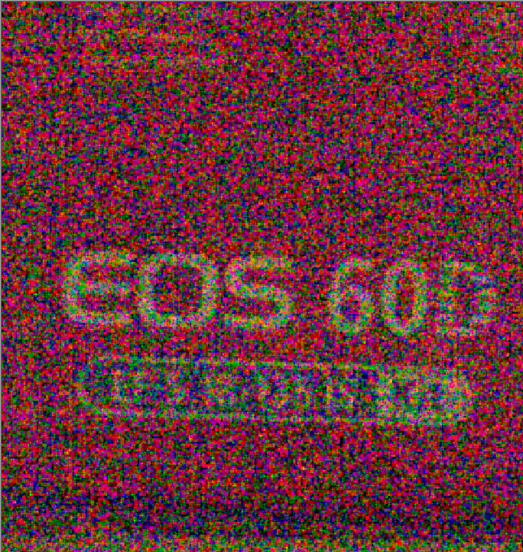
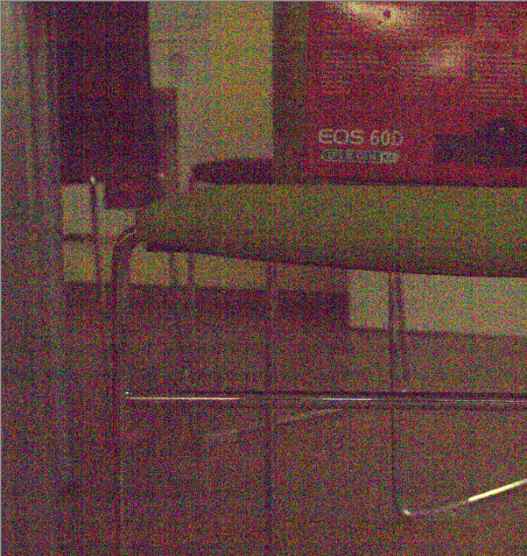
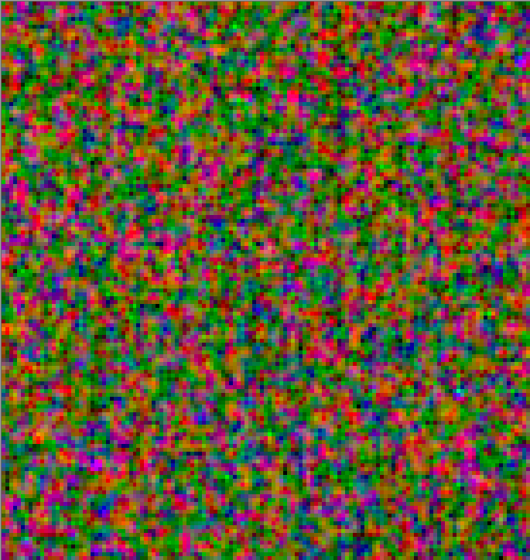
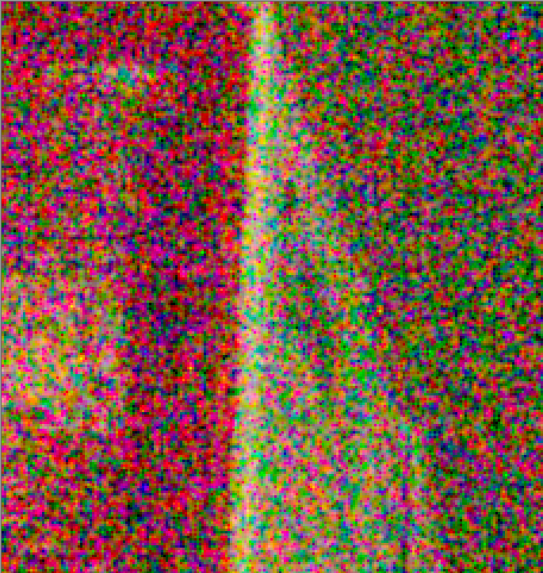
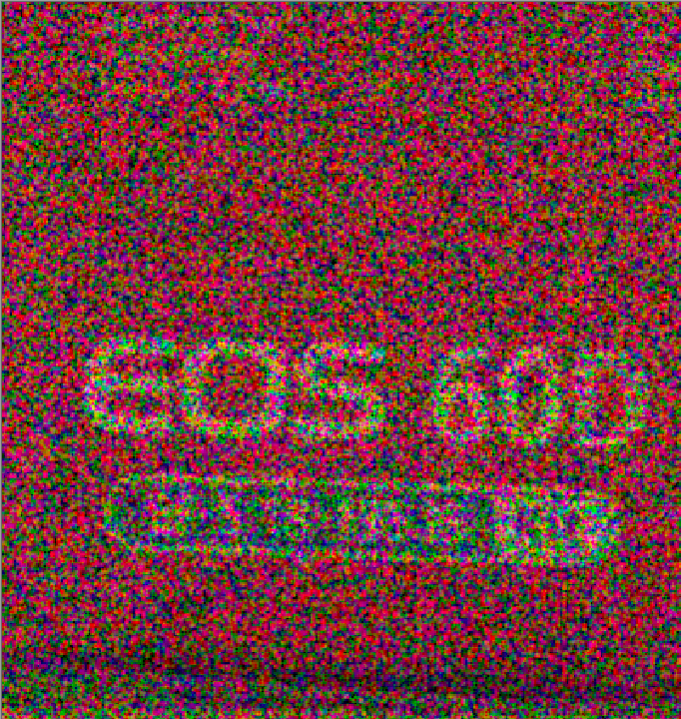
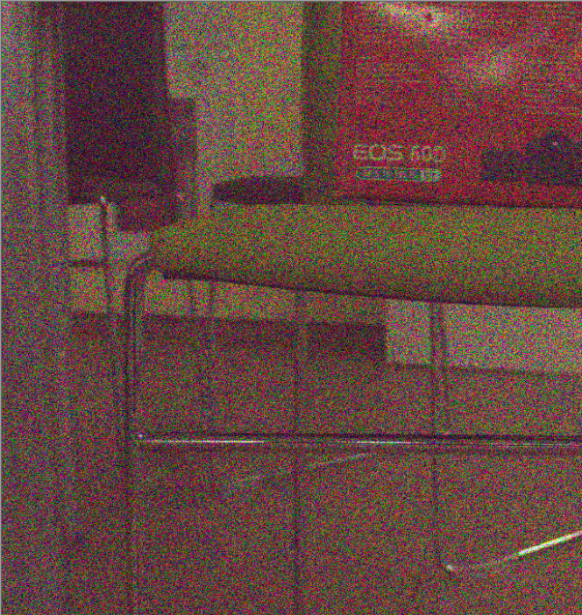
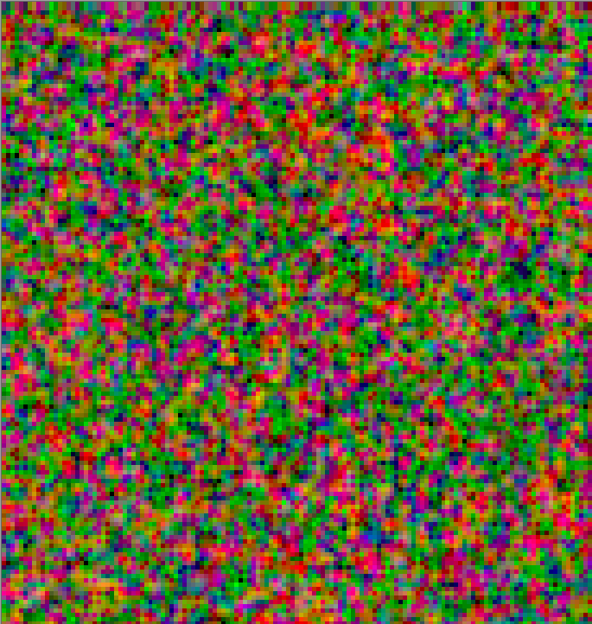
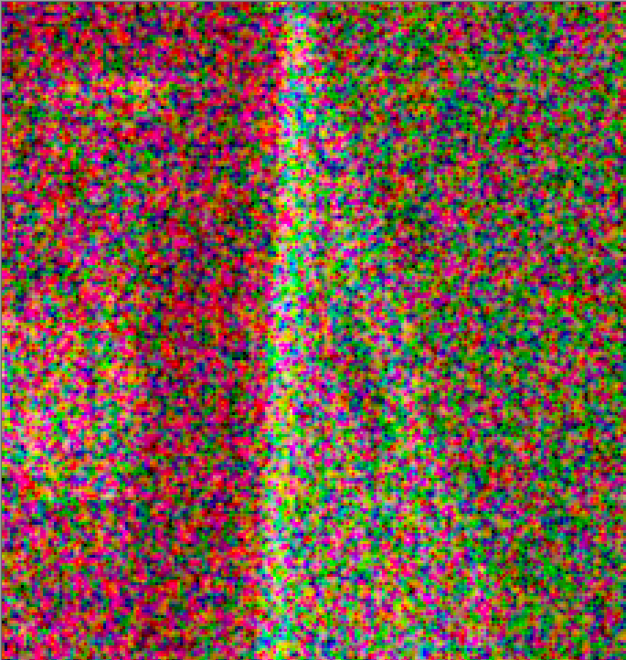
Experiment 1 (ISO = 320, aperture = f/4, a = 0.4, b = 0.0004)
Real low-light
Shutter = 1/2650
Synthetic low-light
Shutter = 1/20

Slide 4
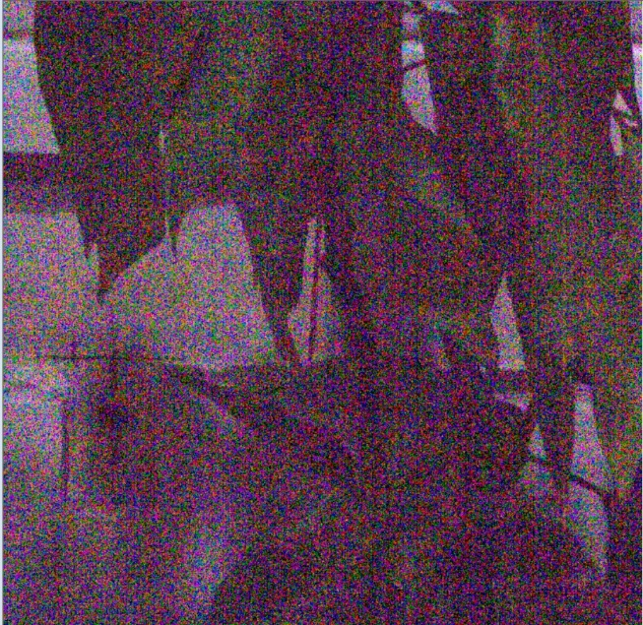
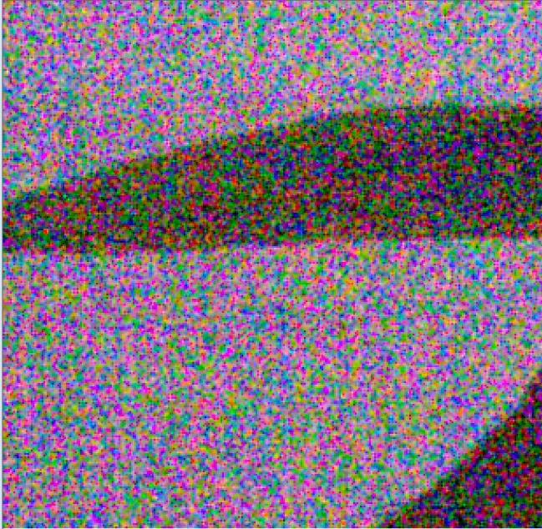
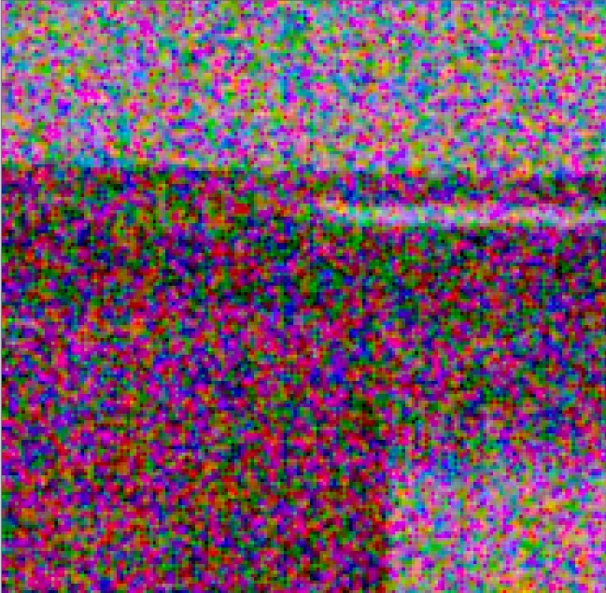
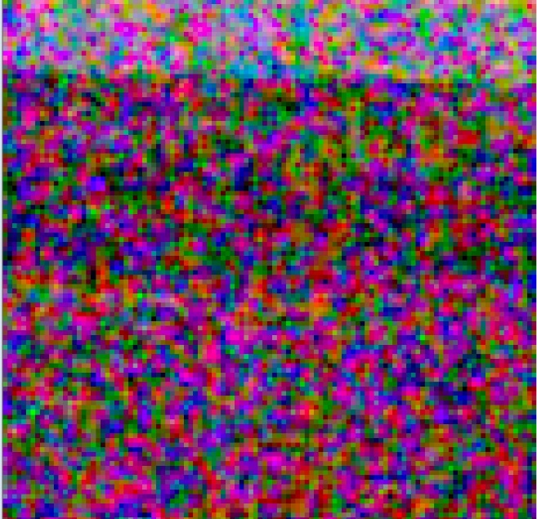
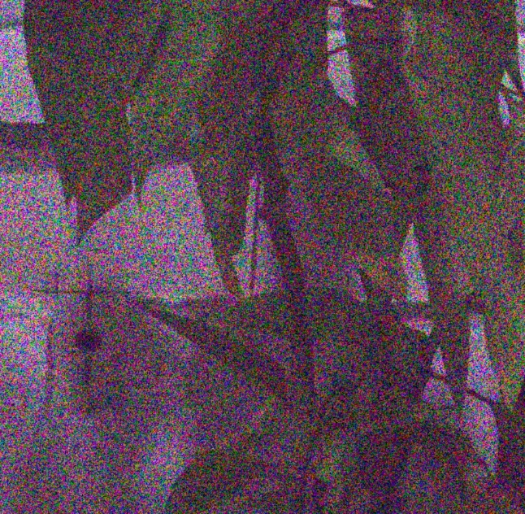
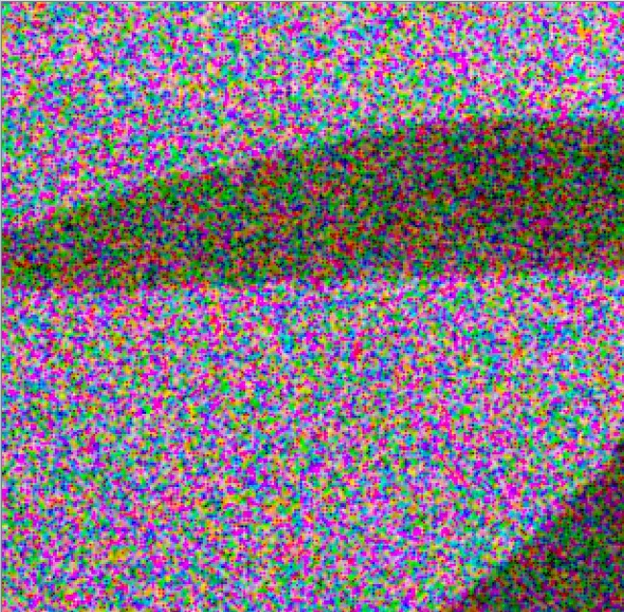
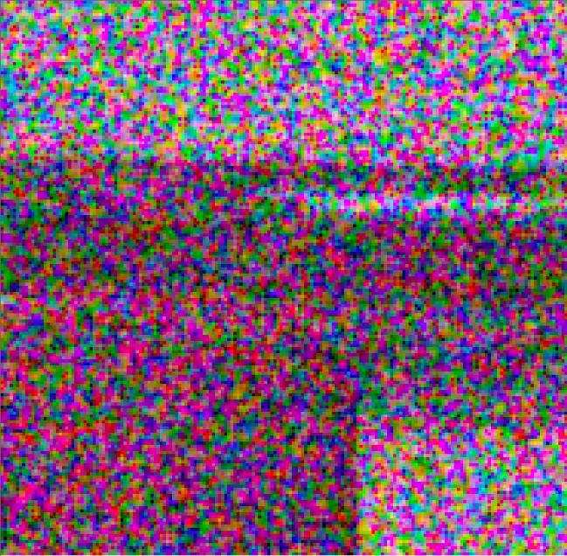
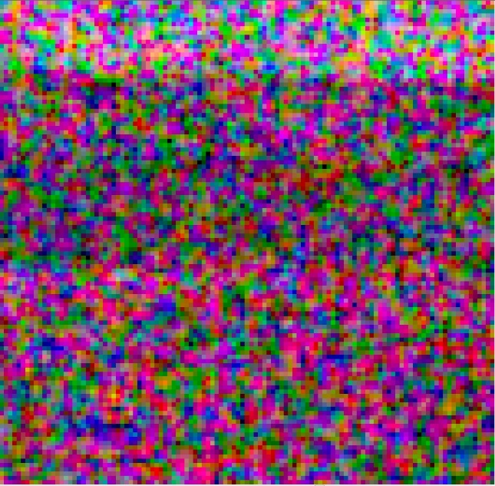
Experiment 2 (ISO = 400, aperture = f/6, a = 0.15, b = 0.001)
Real low-light
Shutter = 1/1328
Synthetic low-light
Shutter = 1/10

Slide 5
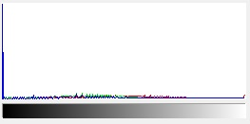
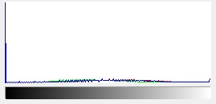
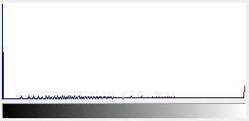
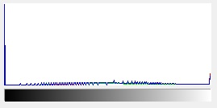
histogramms
Experiment 1
Experiment 2
Real low-light
Synthetic low-light
On a histogram with synthetic noise, it can be seen that the number of white pixels is larger than on a real image,
which explains the lighter and contrasted simulated noise.

Slide 6
Differences between synthetic and real noise image
The image, basically noise, depends heavily on the interpolation method;
For example, when using dcraw, "stripes" appeared on the image using AHD or PPG , but they were absent using bilinear and VNG methods;
There wasn’t difference in the application of noise before or after WB calculation.

